Slide 1


Slide 2

Have you considered a
CAREER IN EYECARE?

Slide 3
<Your name here>
<Your job title here>
<Your company name here>
Notes:
2 minutes
Introduce yourself and explain what the lesson will achieve:
Research roles in eyecare and eyewear
Look at the different sectors that you can work in whilst working in eyecare and eyewear

Slide 4



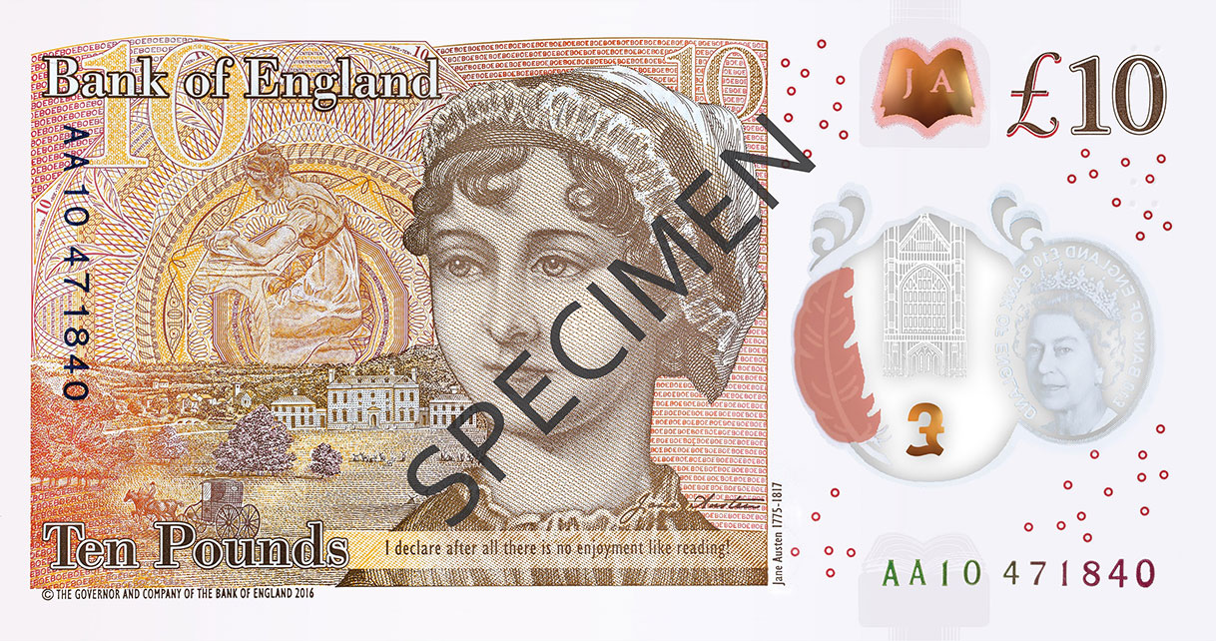
Notes:
2 minutes
Brief introduction to ABDO
Mention Godmersham and NRC in Birmingham
If you wish, mention Godmersham features on the Jane Austen side of the £10 note and why.
It was inherited by her brother Edward Austen in 1794.
Jane Austen was a regular visitor between 1798 and 1813.

Slide 5


Notes:
2 minutes
Click on the logo to access the website.
Introduce Youth Employment UK to students
Youth Employment UK provides free membership called Young Professional to all 14-24 year olds in the UK. This membership is accessed online and helps young people to build up skills for life and work.
In addition, Youth Employment UK is home to a growing Careers Hub that provides useful information about the world of work, careers, pathways, salary information, tips, advice and much more. Students are going to use the Careers Hub today to learn more about the world of work, and to build their skills for making career choices, researching information and improving their job searching skills.

Slide 6

Notes:
2 minutes
Click on the slide to access Careers In Eyecare (this is the page that they will be using)
Introduce Careers in Eyecare to students
Site within Youth Employment UK created by ABDO
Help to find out about different jobs
Help on apprenticeships, interviews, real life experiences

Slide 7
15 different sectors in the UK
Agriculture, Environmental
and Animal Care
Business and Administration
Catering and Hospitality
Childcare and Education
Construction
Creative and Design
Digital
Engineering and Manufacturing
Finance, Accounting and Legal
Hair and Beauty
Health and Science
Protective Services
Sales, Marketing and Procurement
Social Care
Transport & Logistics
Notes:
Show the 15 key sectors in the UK and ask students where they think eyecare may be placed:
It is anticipated that they will choose Health & Science.

Slide 8
15 different sectors in the UK
Agriculture, Environmental
and Animal Care
Business and Administration
Catering and Hospitality
Childcare and Education
Construction
Creative and Design
Digital
Engineering and Manufacturing
Finance, Accounting and Legal
Hair and Beauty
Health and Science
Protective Services
Sales, Marketing and Procurement
Social Care
Transport & Logistics
Notes:
Show the 15 key sectors in the UK and ask students where they think eyecare may be placed:
It is anticipated that they will choose Health & Science.

Slide 9

Science
Technology
Engineering
Mathematics
Notes:
1 minute
What is STEM and how is it relevant to careers in eyecare
Point out that most eyecare careers need a good foundation in STEM subjects.

Slide 10


YOUR
TASK
Notes:
2 minutes
NB you may find it easier and quicker to allocate careers to the groups.
Set the task
Tell students that they are going to research some careers on the Careers in Eyecare pages.
In pairs or small groups they are to find a career where one needs to have a good understanding of one or more STEM subjects.
Once they have chosen their career they are then going to research it and present what they find back to the class in a 1 minute presentation.
They can use paper or IT-based presentation tools to do their presentation.

Slide 11

Ophthalmic Nurse
Optical Sales Representative
Optometerist
Optical Practice Manager
Eye Clinic Liaison Officer
Ophthalmologist
Orthoptist
Low Vision Optician
Contact Lens Optician
Optical Laboratory Technician
Dispensing Optician
Optical Assistant
Notes:
5 minutes
Students navigate to the Careers in Eyecare page.
If possible, ask the school IT department to put the link onto the machines ready.
Students make their career choices from the Careers in Eyecare page.
You may choose to allocate careers to the pairs/groups to get a better range of roles

Slide 12
Whilst researching the chosen career, prepare a presentation and choose who will present back to the class.
You should information such as:
Description of that job
What it involves
What qualifications you need
How much might you earn in this career
Name a local employer in eyecare
Name a national employer in eyecare
Which of the 15 key sectors do they think the job fits into
What lessons at school could be the most useful for this career and why?
Notes:
15-20 minutes
Whilst researching their career, students prepare their presentation. Ask them to present information such as (see slide)
Their presentation only needs to be 1-2 minutes long per group.
You can give more time if the class size is small.
If they are unwilling to present, ask them to stay seated and to tell you what they found. You can then summarise to the class if they couldn’t hear and also add further information as needed.

Slide 13


Slide 14
YOUR
PRESENTATIONS
Notes:
2 minutes per group
Students deliver their presentation.
If they are unwilling to present, ask them to stay seated and to tell you what they found. You can then summarise to the class if they couldn’t hear and also add further information as needed.

Slide 15
15 different sectors in the UK
Agriculture, Environmental
and Animal Care
Business and Administration
Catering and Hospitality
Childcare and Education
Construction
Creative and Design
Digital
Engineering and Manufacturing
Finance, Accounting and Legal
Hair and Beauty
Health and Science
Protective Services
Sales, Marketing and Procurement
Social Care
Transport & Logistics
Notes:
3 minutes
Revisit the 15 sectors and highlight those that fall within eyecare and eyewear.
It is anticipated there will be roles within:
Business & Administration (practice manager)
Creative & Design (frame design)
Engineering & Manufacturing (lab technician, frame manufacturing, lens manufacturing, equipment)
Health & Science (all roles)
Sales, Marketing & Procurement (Frame sales rep) NB other roles such as OA, DO, CLO and Optom also have an element of sales.

Slide 16
AND FINALLY
What have you learnt about the world of work?
What have you learnt about careers in eyecare?
Are there more roles and careers than you thought?
Did anyone find a career they like?
Notes:
7 minutes
What have students learnt about the world of work?
What have students learnt about careers in eyecare?
Are there more roles and careers than they thought?
Did anyone find a career they like?

Slide 17
ANY
QUESTIONS?

Slide 18
Good luck and
THANK YOU
FOR YOUR TIME

Slide 20


